Slide 2
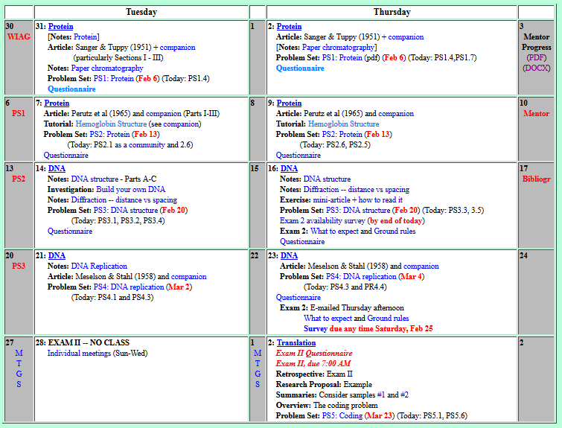
Welcome to Molecular Biology Through Discovery Thursday, 16 February 2017

Slide 3
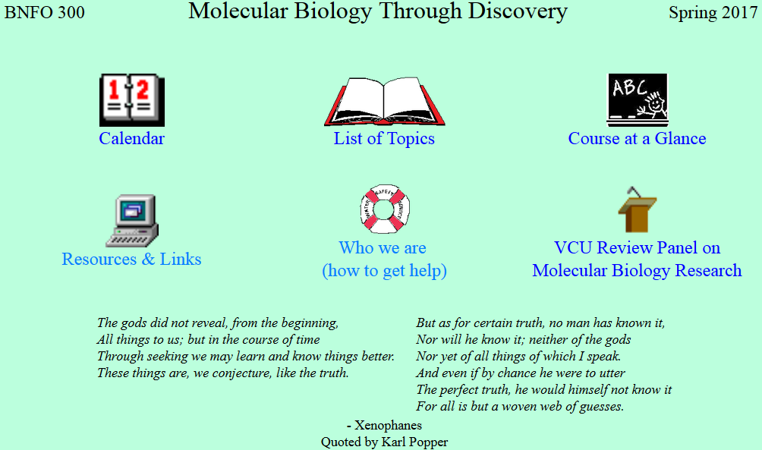

Slide 4
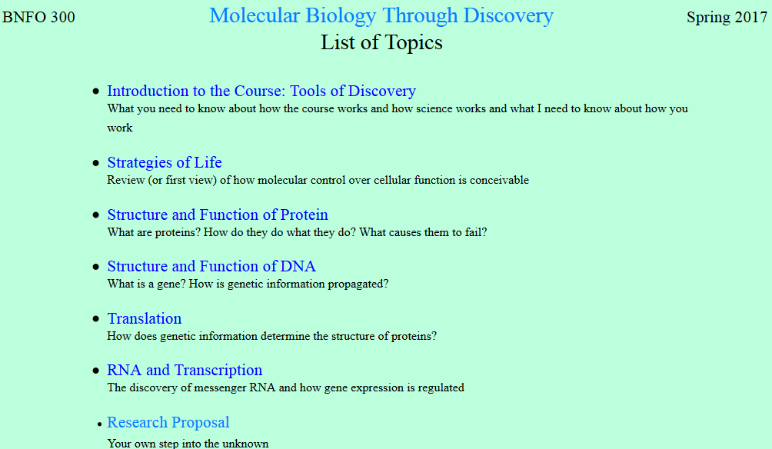

Slide 5
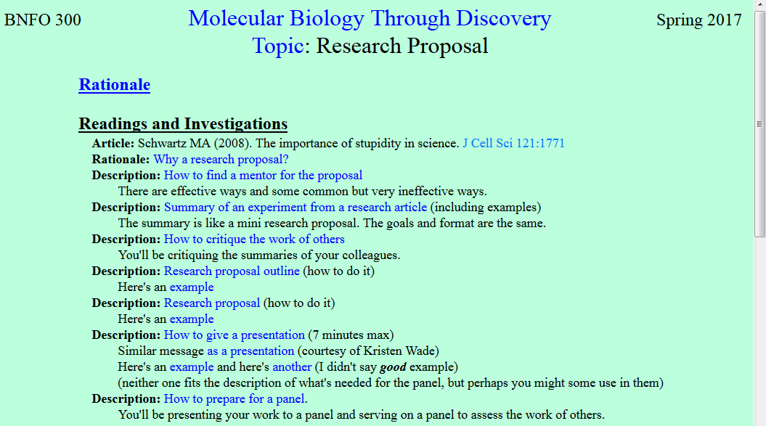

Slide 6
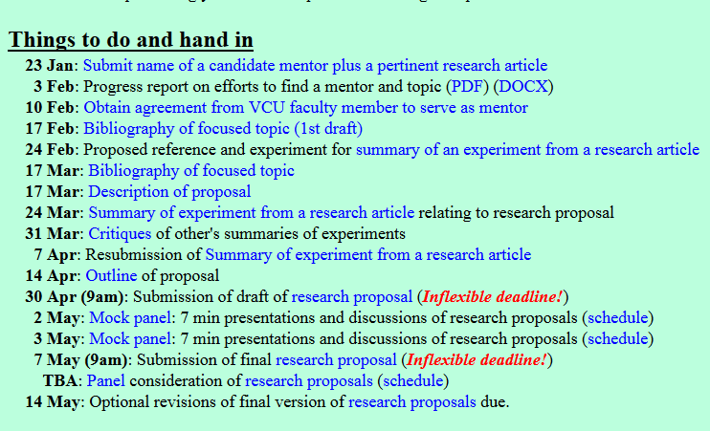

Slide 7
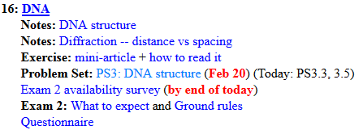
Welcome to Molecular Biology Through Discovery Tuesday, 14 February 2017

Slide 8
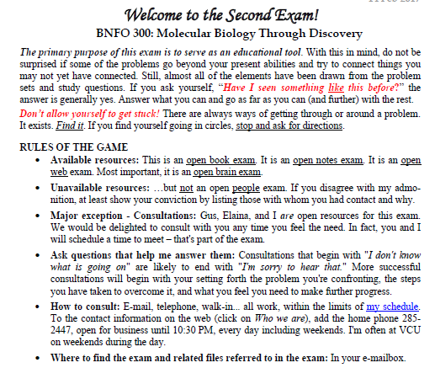

Slide 9
Welcome to Molecular Biology Through Discovery Tuesday, 14 February 2017

Slide 10
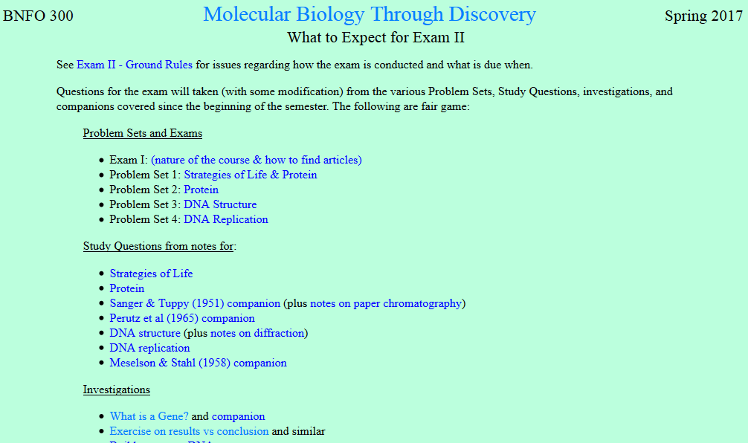
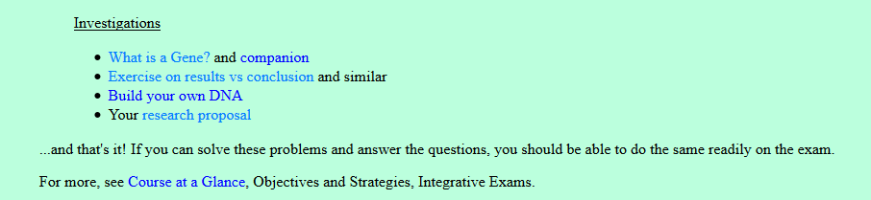

Slide 11
Welcome to Molecular Biology Through Discovery Tuesday, 14 February 2017

Slide 12
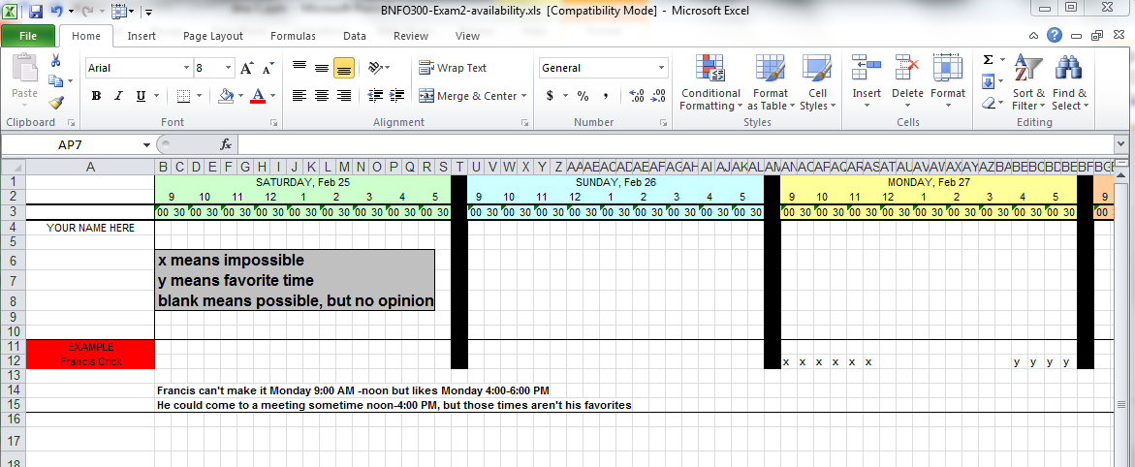

Slide 13
Welcome to Molecular Biology Through Discovery Tuesday, 14 February 2017

Slide 14
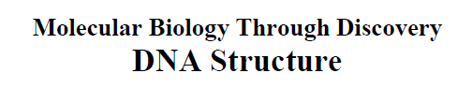
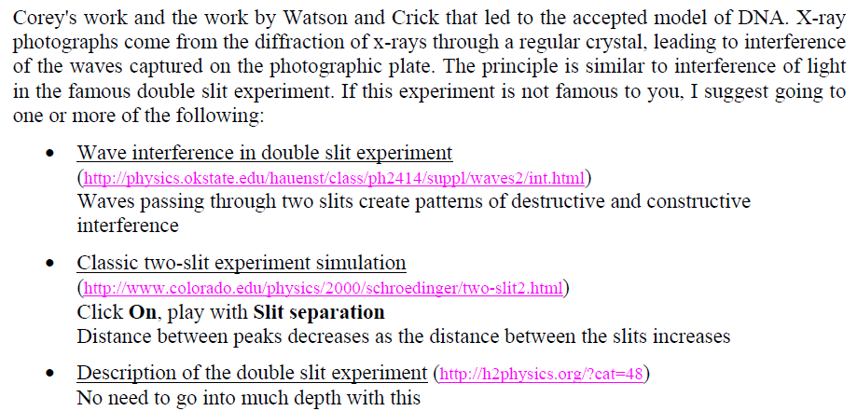

What is the difference between destructive and constructive interference?
Did you know that http://www.colorado.edu/physics/2000/schroedinger/two-slit2.html returns a 404 error?

Slide 15
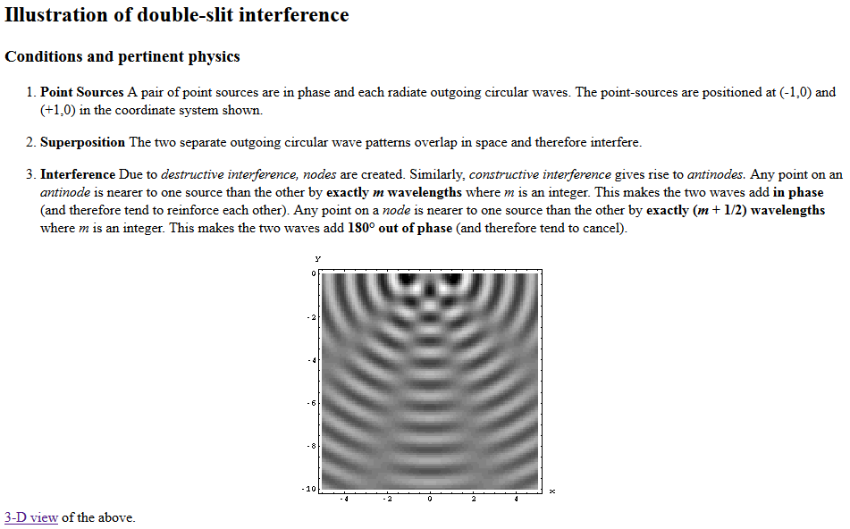
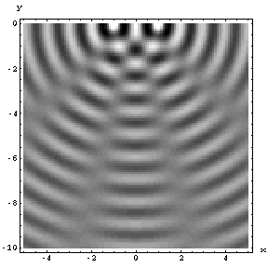
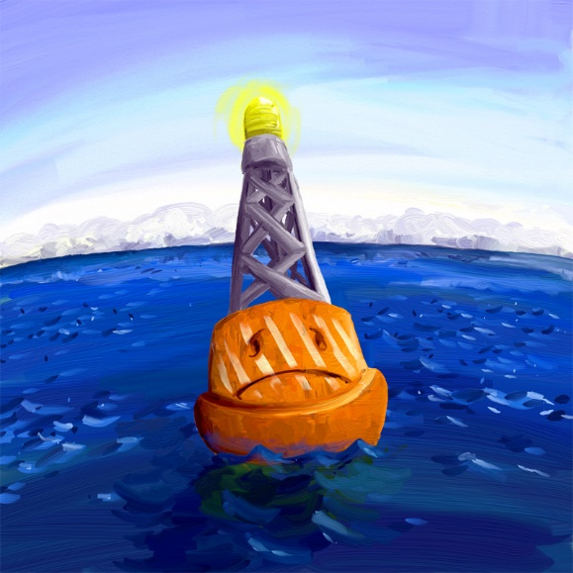
d
θ

Slide 16
d
θ

Slide 17

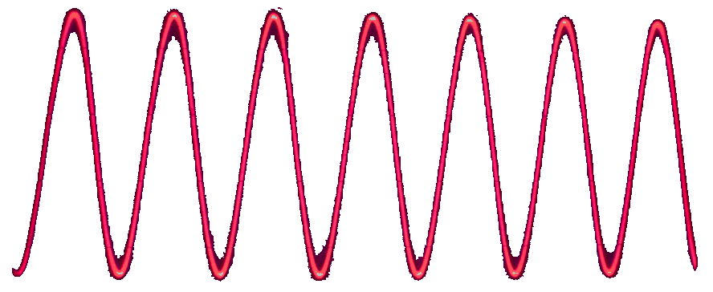
DNA Structure Simple Mathematical Approach
~1 cm
θ
θ
φ
φ
~3 nanometer
θ
θ
d
1 wavelength ( = λ)
= d
Sin θ
Sin θ
n
= 2d
= λ

Slide 18
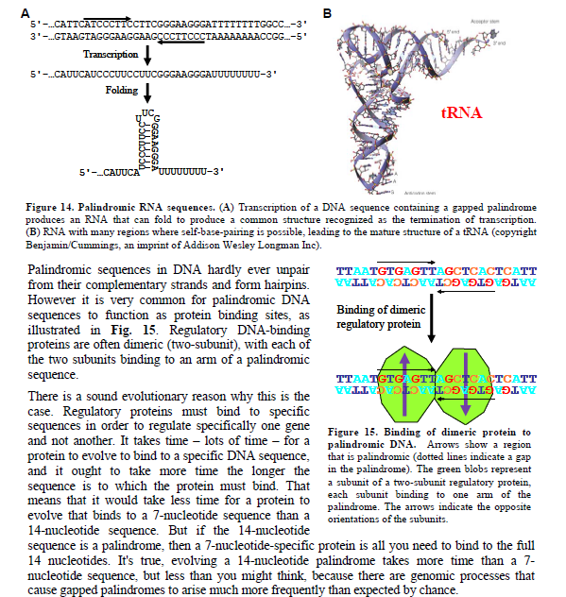
Would you mind going over the biological roles for palindromic sequences?

Slide 19
Palindromic Sequences
What is it?
Backwards = forwards
ROTATOR
GCTATCG
What about with DNA?
DNA is double stranded
TTAATGTGAGTTAGCTCACTCATT AATTACACTCAATCGAGTGAGTAA

Slide 20
Palindromic Sequences
What is it?
Backwards = forwards
ROTATOR
GCTATCG
What about with DNA?
DNA is double stranded
DNA is redundant
TTAATGTGAGTTAGCTCACTCATT AATTACACTCAATCGAGTGAGTAA

Slide 21
Palindromic Sequences
What is it?
Backwards = forwards
ROTATOR
GCTATCG
What about with DNA?
DNA is double stranded
DNA is redundant
DNA has direction (read 5’->3’)
5’- -3’
3’- -5’
TTAATGTGAGTTAGCTCACTCATT
TTAATGTGAGTTAGCTCACTCATT AATTACACTCAATCGAGTGAGTAA
AATGAGTGAGCTAACTCACATTAA

Slide 22
Palindromic Sequences
Palindromic sequences as structural RNA
5’- -3’
3’- -5’
TTAATGTGAGTTAGCTCACTCATT AATTACACTCAATCGAGTGAGTAA
TA T G GC AT GC TA GC TTAAT TCATT AATTA AGTAA CG TA CG AT CG G T AT
DNA: cruciform
RNA: stem/loop

Slide 23
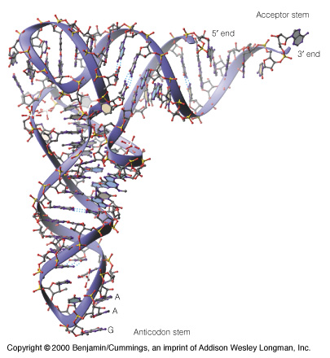
Palindromic Sequences
Palindromic sequences as structural RNA
5’- -3’
3’- -5’
TTAATGTGAGTTAGCTCACTCATT AATTACACTCAATCGAGTGAGTAA
UA U G GC AU GC UA GC UUAAU UCAUU
tRNA
DNA: cruciform
RNA: stem/loop

Slide 24
Palindromic Sequences
Palindromic sequences as protein binding sites
NNNNNNNNNNNNNNN NNNNNNNNNNNNNNN
TTAATGTGAGTTAGCTCACTCATT
NNNNNNNNNNNNN NNNNNNNNNNNNN
AATGAGTGAGCTAACTCACATTAA
recognizes GTGAGTT

Slide 25
Palindromic Sequences
Palindromic sequences as protein binding sites
NNNNNNNNNNNNNNN NNNNNNNNNNNNNNN
TTAATGTGAGTTAGCTCACTCATT
NNNNNNNNNNNNN NNNNNNNNNNNNN
AATGAGTGAGCTAACTCACATTAA

Slide 26
Palindromic Sequences
Palindromic sequences as protein binding sites
NNNNNNNNNNNNNNN NNNNNNNNNNNNNNN
TTAATGTGAGTTAGCTCACTCATT
NNNNNNNNNNNNN NNNNNNNNNNNNN
AATGAGTGAGCTAACTCACATTAA

Slide 27
Palindromic Sequences
Palindromic sequences as protein binding sites
NNNNNNNNNNNNNNN NNNNNNNNNNNNNNN
TTAATGTGAGTTAGCTCACTCATT
NNNNNNNNNNNNN NNNNNNNNNNNNN
AATGAGTGAGCTAACTCACATTAA

Slide 28
Palindromic Sequences
Palindromic sequences as protein binding sites
NNNNNNNNNNNNNNN NNNNNNNNNNNNNNN
TTAATGTGAGTTAGCTCACTCATT
NNNNNNNNNNNNN NNNNNNNNNNNNN
AATGAGTGAGCTAACTCACATTAA

Slide 29
recognizes GTGAGTT
Palindromic Sequences
Palindromic sequences as protein binding sites
NNNNNNNNNNNNNNN NNNNNNNNNNNNNNN
TTAATGTGAGTTAGCTCACTCATT
NNNNNNNNNNNNN NNNNNNNNNNNNN
AATGAGTGAGCTAACTCACATTAA

Slide 30
Palindromic Sequences
Palindromic sequences as protein binding sites
NNNNNNNNNNNNNNN NNNNNNNNNNNNNNN
TTAATGTGAGTTAGCTCACTCATT
NNNNNNNNNNNNN NNNNNNNNNNNNN
AATGAGTGAGCTAACTCACATTAA

Slide 31
Palindromic Sequences
Palindromic sequences as protein binding sites
NNNNNNNNNNNNNNN NNNNNNNNNNNNNNN
TTAATGTGAGTTAGCTCACTCATT
NNNNNNNNNNNNN NNNNNNNNNNNNN
AATGAGTGAGCTAACTCACATTAA

Slide 32
Palindromic Sequences
Palindromic sequences as protein binding sites
NNNNNNNNNNNNNNN NNNNNNNNNNNNNNN
TTAATGTGAGTTAGCTCACTCATT
NNNNNNNNNNNNN NNNNNNNNNNNNN
AATGAGTGAGCTAACTCACATTAA
Palindromes: Serve as binding sites for dimeric protein

Slide 33
Palindromic Sequences
Palindromic sequences as protein binding sites
gene
5’-GTA ..(8).. TACNNNNNNNNNNTANNNTNNNNNNNNNNNNNNNNNNNNNNNNNNNNATGNNNNNNNNNNNNNNNN 3’-CAT ..(8).. ATGNNNNNNNNNNATNNNANNNNNNNNNNNNNNNNNNNNNNNNNNNNTACNNNNNNNNNNNNNNNN
GTA ..(8).. TAC
RNA Polymerase

Slide 34
Palindromic Sequences
Palindromic sequences as protein binding sites
gene
5’-GTA ..(8).. TACNNNNNNNNNNTANNNTNNNNNNNNNNNNNNNNNNNNNNNNNNNNATGNNNNNNNNNNNNNNNN 3’-CAT ..(8).. ATGNNNNNNNNNNATNNNANNNNNNNNNNNNNNNNNNNNNNNNNNNNTACNNNNNNNNNNNNNNNN
Transcription factor
RNA
GTA ..(8).. TAC
RNA Polymerase
I get that they help with protein binding and stuff but the hairpin structure thing confused me.
I'm specifically concerned about how the sequence has to match the next 5' to 3' strand.
I have looked up several hairpin structures and none of them are DNA palindromes

Slide 35
Palindromic Sequences
Palindromic sequences as structural RNA
5’- -3’
3’- -5’
TTAATGTGAGTTAGCTCACTCATT AATTACACTCAATCGAGTGAGTAA
UA U G GC AU GC UA GC UUAAU UCAUU
tRNA
DNA: cruciform
RNA: stem/loop

Slide 36
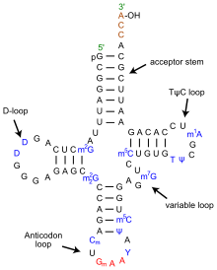
Palindromic Sequences
Palindromic sequences as structural RNA
I have looked up several hairpin structures and none of them are DNA palindromes
tRNA

Slide 37
Palindromic Sequences
Palindromic sequences as structural RNA
I have looked up several hairpin structures and none of them are DNA palindromes
tRNA

Slide 38
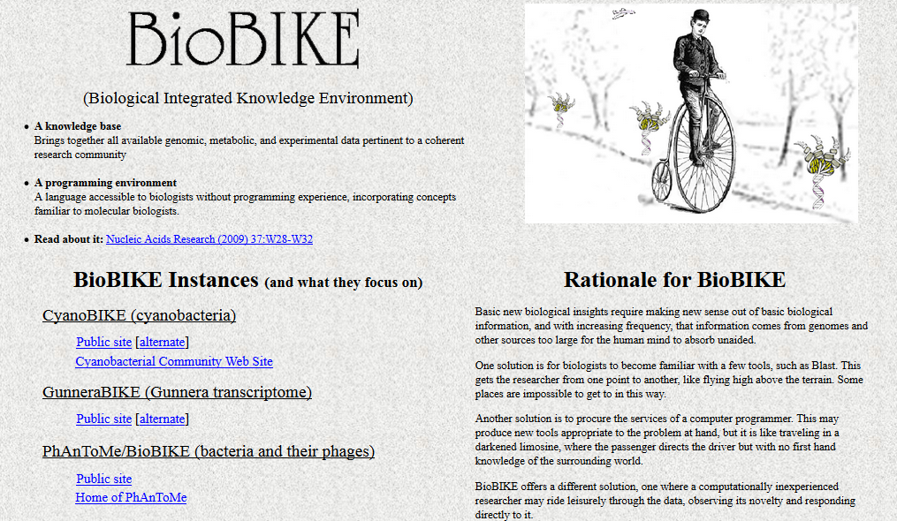

Slide 39

Find the palindromes
Me
1N
1S
2N
2S
3N
3S
4N
4S
5N
5S
6N
6S
7S

Slide 40
Find the palindromes
Me
Connect to: https://vcu.zoom.us/j/2504526209
1N
1S
2N
A
B
C
D
2S
3N
3S
4N
E
F
G H
4S
5N
5S
6N
I J
K
L
6S
7S

Slide 41
Palindromic Sequences
Palindromic sequences as structural RNA
I have looked up several hairpin structures and none of them are DNA palindromes
tRNA

Slide 42
Find the palindromes
Your group’s considered opinion (conclusion)
Justification (result / method)
Organized on a slide or page (to be shared – Zoom)
One intentional error

Slide 43
I'm having trouble interpreting Chargaff's data…. Why doesn't the sum of all the nucleotides not equal 1?

Slide 44
DNA Before Double Helix
I'm having trouble interpreting Chargaff's data…. Why doesn't the sum of all the nucleotides not equal 1?

Slide 45
DNA Before Double Helix
I'm having trouble interpreting Chargaff's data…. Why doesn't the sum of all the nucleotides not equal 1?

Slide 46
DNA Before Double Helix
I'm having trouble interpreting Chargaff's data…. Why doesn't the sum of all the nucleotides not equal 1?

Slide 47
DNA Before Double Helix
I'm having trouble interpreting Chargaff's data…. Why doesn't the sum of all the nucleotides not equal 1?

Slide 48
DNA Before Double Helix
I'm having trouble interpreting Chargaff's data…. Why doesn't the sum of all the nucleotides not equal 1?

Slide 49
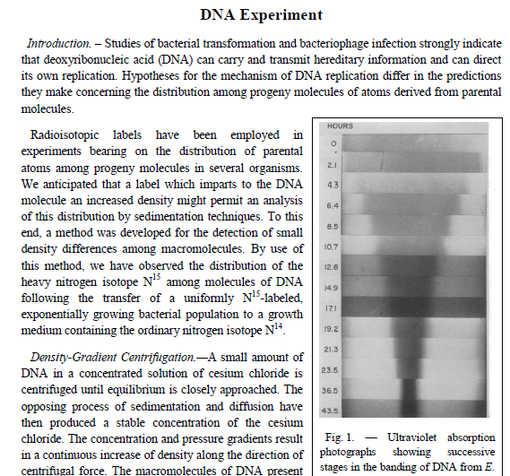
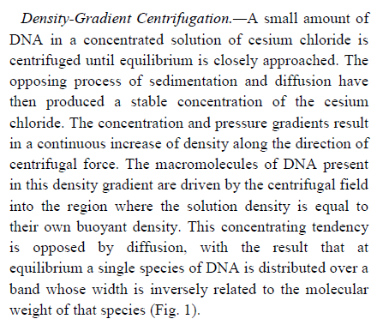
What exactly does the article mean by "at equilibrium"?

Slide 50
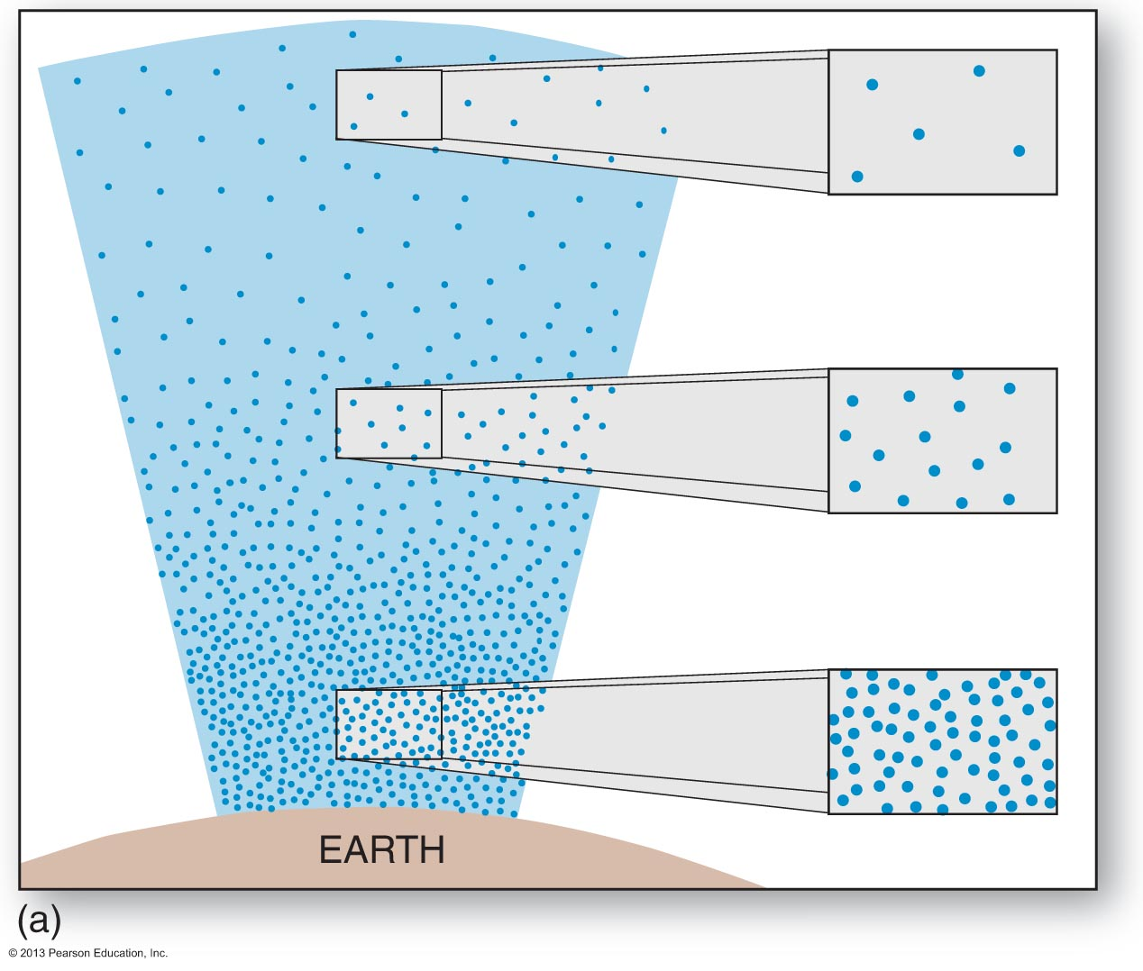
Why is there an atmosphere?
g r a v I t y
d i f f u s I on

Slide 51
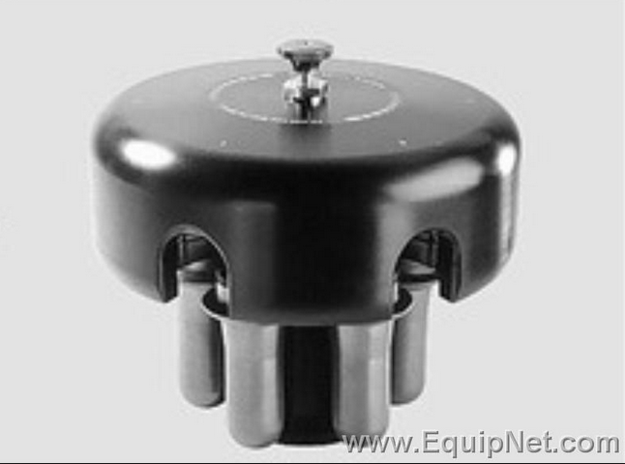
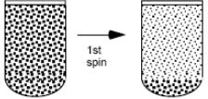
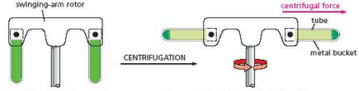
What is centrifugation?

Slide 52
What is centrifugation?
DNA

Slide 53
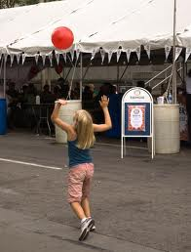
Where does it go?

Slide 54

Where does it go?

Slide 55
Where does it go?
g r a v I t y
d i f f u s I on

Slide 56
Where does it go?
g r a v I t y
d i f f u s I on

Slide 57
Where does it go?
g r a v I t y
d i f f u s I on

Slide 58
What exactly does the article mean by "at equilibrium"?

Slide 59
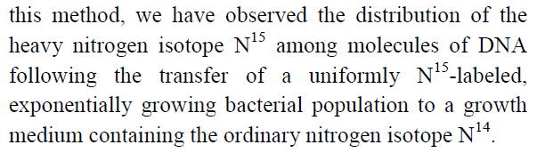
…does that mean the used an isotope of nitrogen as a dye to locate it after centrifuging the bacterial DNA?

Slide 60
Where does it go?
g r a v I t y
d i f f u s I on

Slide 61
Where does it go?
g r a v I t y
d i f f u s I on

Slide 62
Welcome to Molecular Biology Through Discovery Tuesday, 14 February 2017

Slide 63
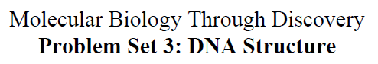
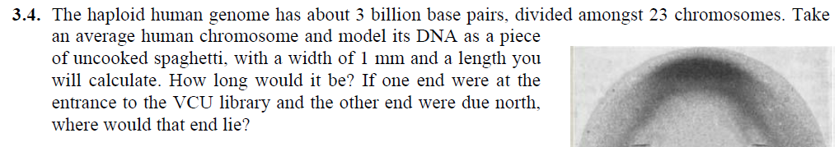
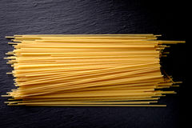
For question 4, what is a single strand of spaghetti supposed to represent in the model?

Slide 64
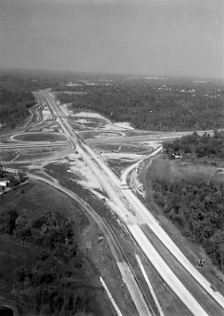
For question 4, what is a single strand of spaghetti supposed to represent in the model?

Slide 65
For question 4, what is a single strand of spaghetti supposed to represent in the model?

Slide 66
For question 4, what is a single strand of spaghetti supposed to represent in the model?

Slide 67
For question 4, what is a single strand of spaghetti supposed to represent in the model?

Slide 68
For question 4, what is a single strand of spaghetti supposed to represent in the model?

Slide 69
For question 4, what is a single strand of spaghetti supposed to represent in the model?

Slide 70
For question 4, what is a single strand of spaghetti supposed to represent in the model?

Slide 71
For question 4, what is a single strand of spaghetti supposed to represent in the model?

Slide 72
For question 4, what is a single strand of spaghetti supposed to represent in the model?

Slide 73
For question 4, what is a single strand of spaghetti supposed to represent in the model?

Slide 74
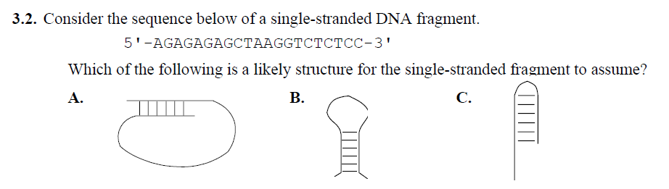
I am stuck on problem 2

Slide 75
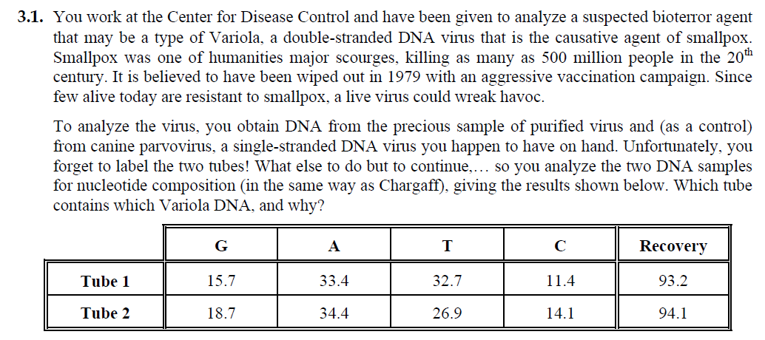
Could you go over problem 1? I was reading through but it is hard to figure out which tube is the one with the single strand based on the given data, is there any specific patterns I should be looking for?

Slide 76
PS3, problems 1,2,3,4,5
Me
Connect to: https://vcu.zoom.us/j/2504526209
1N
1S
2N
A
B
C
D
2S
3N
3S
4N
E
F
G H
4S
5N
5S
6N
I J
K
L
6S
7S

Slide 78
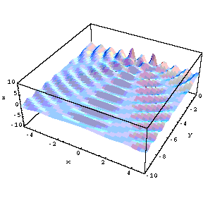

The Double Slit Experiment

Slide 79
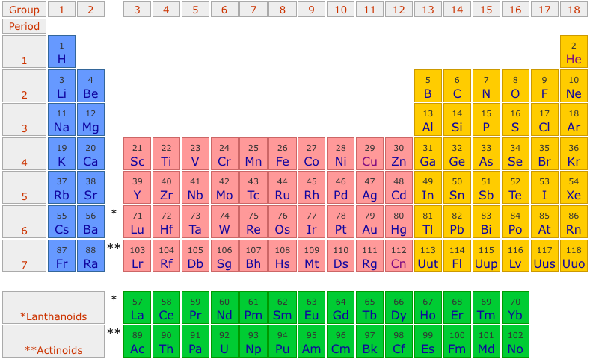
Is DNA heavier than water?
H₂O

Slide 80
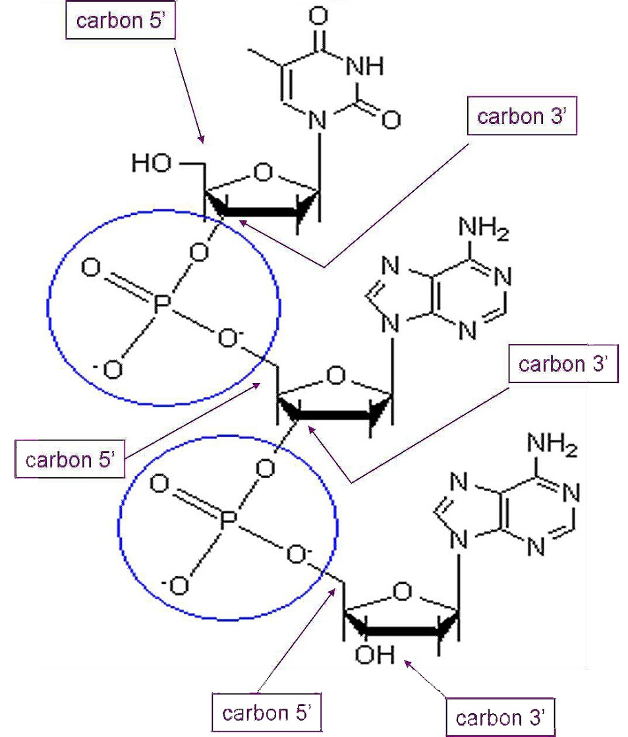
Is DNA heavier than water?
DNA

Slide 81
What is centrifugation?

